Slide 1



TravelGenie
A travel app that grants personalized travel wishes.
Group 3:
Ishan Joshi
Mitesh Singh
Darshil Shah
Prarthana Shetty

Slide 2
INTRODUCTION & OBJECTIVE
Travel planning is an essential part of everyone’s life, whether for leisure, work, or adventure. However, organizing a trip can be overwhelming and time-consuming.
The goal of our project is to provide personalized travel recommendations that helps people plan their trips effectively and easily.

Slide 3
PROBLEM STATEMENT
Travel planning is complex: Modern travelers need to visit multiple scattered platforms to plan a trip.
Lack of personalization: Most tourism websites offer generic suggestions that don't consider individual preferences like budget, travel style, or specific interests.
Challenge: How can we streamline the travel planning experience, offering tailored recommendations based on user preferences and budget in a single platform?

Slide 4
SOLUTION
The idea is to design a Personalized Travel Recommendation System that leverages modern technologies to automate the tedious process of travel planning.
The system will dynamically process user input to collect information about destination preferences, budget, and travel duration to recommend personal travel recommendation in near real-time.
Imagine your prompt as: "I have 10 days off for a vacation, and I'm open to explore a mountain range or relaxing by a beach."

Slide 5
KEY FEATURES
Dynamic Query Handling: Understand incomplete user inputs and fill in the gaps intelligently.
User Personalization: Provide recommendation as per the user preference through hybrid of RAG and Recommendation System.

Slide 6
TOOLS
Python – Programming Language
Streamlit – Frontend
Snowflake – Data Warehouse
DBT – Data Transformation Tool
Airflow – Data Orchestration
OpenAI/HuggingFace/PyTorch/LangChain – ML Modeling, RAG
Pinecone?, ChromaDB? – Vector Database
Graph Database and Knowledge Graph?

Slide 7
RESEARCH & FINDINGS
High demand for personalization (83% of travelers value tailored suggestions)
Improved customer satisfaction (39% of leisure travelers happy with AI recommendations)
Trend of Investment (about $1 billion) and Integration of LLMs in this space
Meeting evolving traveler expectations (63% prefer unique experiences)
Enhanced operational efficiency for travel companies
Mitigation of information overload for consumers

Slide 8
CHALLENGES TO ADDRESS
Data Transformation: Data cleaning and noise reduction from unstructured data
⁠Data Integration: Merging diverse data sources to ensure consistency and quality.
API Management: Handling rate limits, costs, downtimes, and data freshness in APIs.
Ethical and Security Concerns: Navigating legal issues and regulations for scraping data.
Scalability and Performance: Efficiently processing large data volumes in real-time.
Biases in Recommendation: Addressing biases and providing relevant recommendations .

Slide 9
PROJECT PHASES
Requirement Gathering
Data Sourcing and API Integration
Data Engineering
Recommender System & RAG Implementation
Testing & Final Deployment

Slide 10

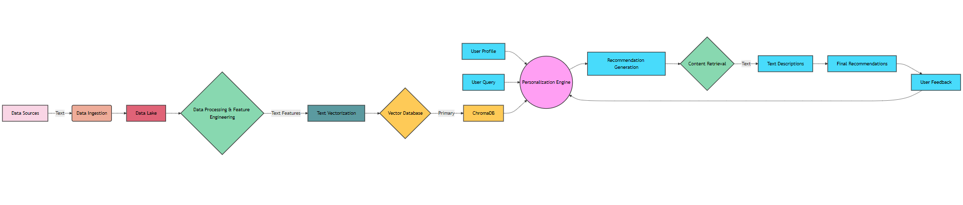
ARCITECTURE DIAGRAM
Architecture Link

Slide 11
ROLES AND RESPONSIBILITIES
Prarthana:- Frontend, Data Analysis, Data Modeling
Ishan:- Technical Architecture (RAG), Data Preparation, AI Eval and AI Integration.
Mitesh:- ML Modeling (RecSys Engine), Research, and Security.
Darshil:- ETL/ELT pipeline, Data Engineering, Data Sourcing

Slide 12
Week 2: Travel Genie
Objective:
LLMs:
Mistral
Phi3
Llama3.2
Knowledge Graph or Vector Database:
Vector Database: ChromaDB or Pinecone
Graph: Neo4j
Scope
Narrow down the scope to few cities only
Data Sourcing:
Amadeus: Connect to Amadeus travel APIs | Amadeus for Developers (Pay as you Used)
Skyscanner: Introduction | API Developer Documentation (skyscanner.net)
OpenWeatherMap: Weather API - OpenWeatherMap
TripAdvisor: Overview (readme.io) - (5000 free requests, Up to 50 calls per second)
Snowflake Marketplace – Prof Recommendation

Slide 13
Thank You

Slide 14



Week 3

Slide 15
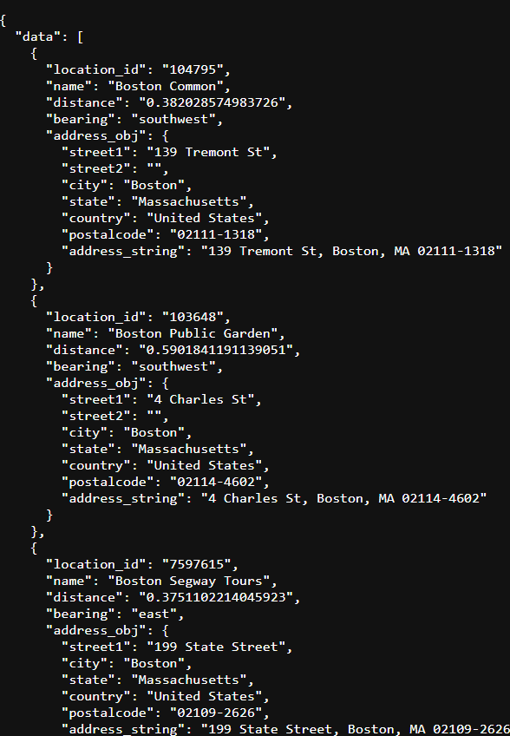
Data Collection
Sample API Data
1. TripAdvisor API
2. Amadeus API
3. Yelp Opensource
4. Web Scraping

Slide 16
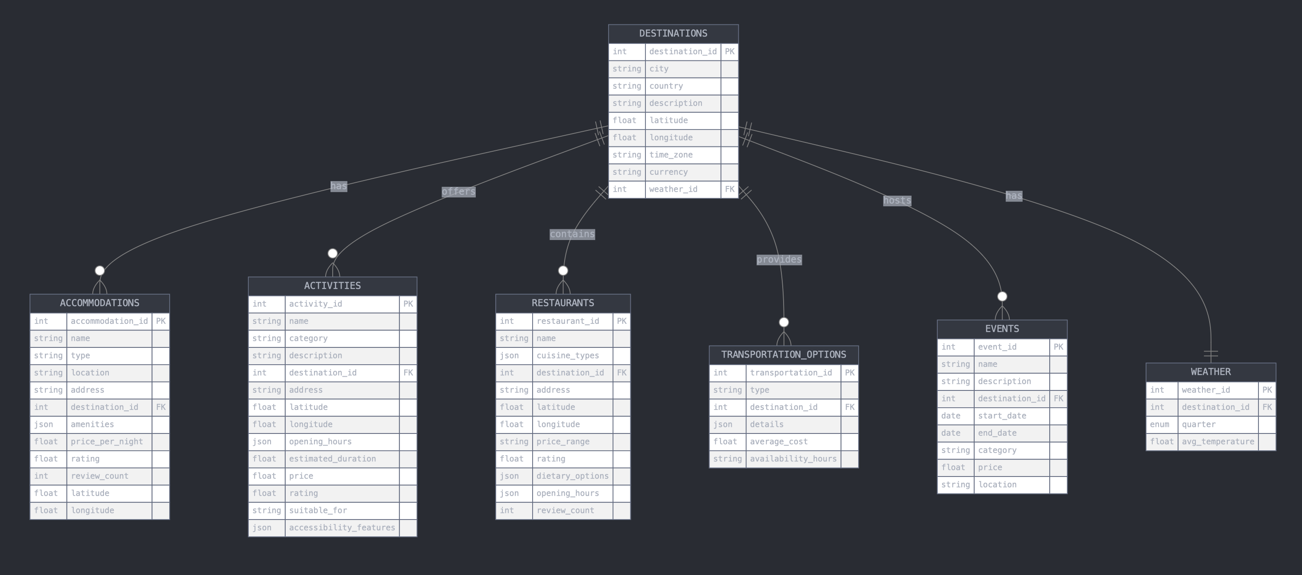
Schema

Slide 17
Explanation of Schema
DESTINATIONS: Stores basic information about travel destinations including location, timezone, and currency.
WEATHER: Contains quarterly average temperature data for each destination, linked to the DESTINATIONS table.
ACCOMMODATIONS: Holds details about lodging options, including type, amenities, pricing, and ratings, associated with destinations.
ACTIVITIES: Captures information about things to do at a destination, including category, duration, pricing, and accessibility features.
RESTAURANTS: Stores data about dining options, including cuisine types, pricing, ratings, and dietary options, linked to destinations.
TRANSPORTATION_OPTIONS: Contains information about available transportation methods at each destination, including type and average cost.
EVENTS: Tracks time-bound occurrences like festivals or concerts at destinations, including dates, categories, and pricing.

Slide 18
Data Profiling & Schema Challenges
Inflexible Categorization: Popular travel destinations often span diverse types of locations, including cities, states, and hill stations, making it challenging to establish a standardized schema for categorization Solution: For the time being, we will focus on defining cities as the primary category for destinations. This will simplify our categorization process and provide a more consistent framework.
The TripAdvisor API does not provide reviews for entire destinations (e.g., New York City). Instead, reviews are only available for specific attractions within those destinations (e.g., Central Park, Statue of Liberty). This limitation makes it difficult to assess the overall appeal of a destination based on user feedback. Solution: Utilize attraction reviews from the TripAdvisor API. While comprehensive reviews for entire cities or destinations are unavailable, we can compile reviews for individual attractions. This allows us to showcase user experiences at notable sites, offering valuable insights to travelers while acknowledging the API's limitations.
Scalability Issues : Due to limited access to the TripAdvisor API, we cannot determine the volume of data we will receive. Once we understand the API call limits and the scope of available data, we can refine our schema to include necessary elements and remove any that are unnecessary. (Events)

Slide 19
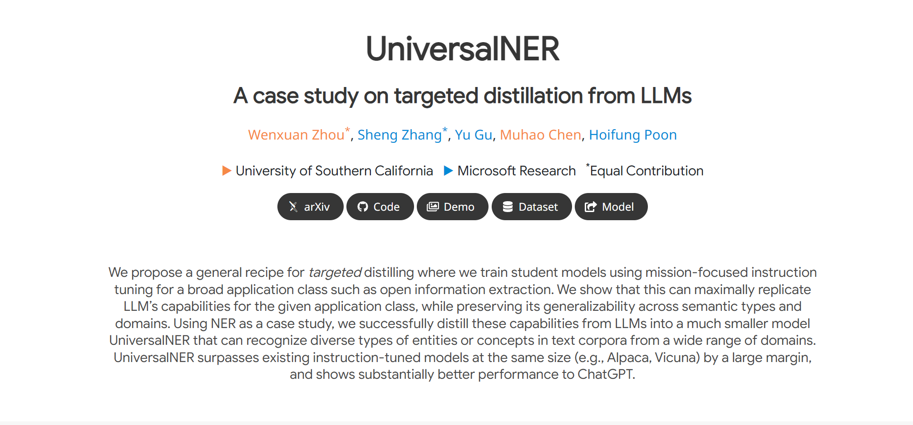
LLM Entity Extraction - Ishan
UniversalNER for Travel Entity Extraction to perform Dynamic Query Handling on User Query.

Slide 20
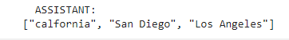
Location Entity Extraction
User Prompt
I have 10 days off for a vacation, and I'm open to explore a mountain range or relaxing by a beach. I am looking for west side like calfornia (San Diego or Los Angeles). I have budget of total $2000.

Slide 21
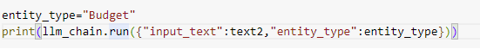
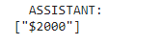
Budget Entity Extraction

Slide 22
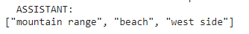
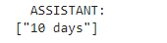
Location Preference and Vacation Duration

Slide 23
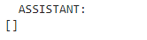
Vacation Start Date

Slide 24
Challenges with UniversalNER
Single Entity Retrevial at a time
Extracted entities requires validation
Compute expensive

Slide 25
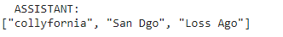
Example:
User Prompt
I have 10 days off for a vacation, and I'm open to explore a mountain range or relaxing by a beach. I am looking for west side like collyfornia (San Dgo or Loss Ago). I have budget of total $2000

Slide 26
Utilizing GPT 4o Mini
User Prompt:
I have 4 days off for a vacation, and I'd like to visit places with a beach and hiking spots. Ideally, I would prefer California. My budget for this trip is $500.
I am interested in exploring cultural landmarks, trying local food, and maybe doing some outdoor activities.
Can you recommend a travel itinerary, including accommodation options, famous landmarks, and affordable places to eat? My vacation starts on 10th Oct and ends on 14th Oct
Please make sure that all recommendations fit within my budget, and include public transport options where necessary.

Slide 27
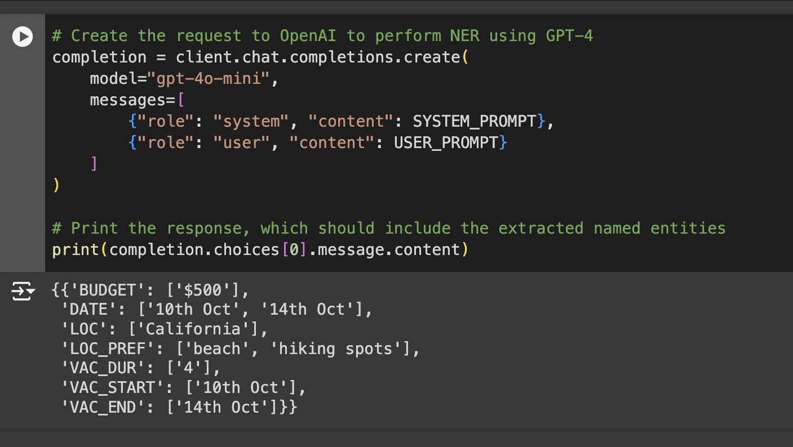

Slide 28
Week 4

Slide 29
Darshil

Slide 30
Prarthana – Data Scraping
Successfully scraped data for 8 cities, approximately 30,000 records for restaurants, hotels, and attractions using Apify and python scripts.
Extracted and organized data for 100 restaurants, 100 hotels, and 100 attractions for each place.
Collected 10 reviews for each of these restaurants, hotels, and attractions, accumulating a significant dataset with a well-rounded set of user feedback and ratings across various locations and categories.
Refined Scripts for automating the process of gathering reviews for attractions.

Slide 31
Challenges Faced
Limitations on Free Credits: Apify provides a limited free credit of $5 per account, and I created 3 different accounts to gather sufficient data. Despite that, I encountered restrictions as some credits were wasted when the API failed to fetch data for certain cities. This made it challenging to utilize the credits efficiently, and I had to prioritize the data collection for key cities.
API Failures and Incomplete Data: Some cities' API calls failed due to server issues, which led to time and resource losses. Additionally, some places provided incomplete data or had fewer reviews than expected, requiring further adjustment of the scraping script and handling of missing data.
Identifying and Filtering Relevant Information

Slide 32
Data Profiling and Potential Next Steps
Attractions:- id, name, city, state, postal code , category, sub-category, rating, review, review_text
Hotels:- id, name, city, state, postal code , amenities, price range, rating, review, review_text
Restaurants:- id, name, city, state, postal code, cuisines, price range, rating, avg_ranking, review, review_text
Flights:- id, Airline name, source, destination, avg_price, rating, review, review_text
Weather:- id, max, min, wind_speed, precipitation, description

Slide 33
Things to address
Data Scraped is all over the place. For example, using the API, scraped data for places and their reviews and descriptions are being generated as different files.
Transportation details are not completely extracted, we are trying a way to figure out a way to deal with that

Slide 34
Ishan
Perform LLMs model benchmarking for multiple entity extraction from user prompt.
Models Benchmarked:
Phi3 (microsoft/Phi-3-mini-128k-instruct)
Gemma2 (google/gemma-2-2b-it)
Llama3.2 (meta-llama/Llama-3.2-3B-Instruct)
Qwen2 (Qwen/Qwen2-1.5B-Instruct)

Slide 35
Performance Overview
Model | Execution Time | Spelling Correction | Entity Accuracy | Notes
Phi3 | 6.7s | Correct | High | Best for speed and accuracy
Gemma2 | 2m 18.4s | Correct | High | Accurate but very slow
Llama3.2 | 45.6s | Missed | Moderate | Average performance overall
Qwen2 | 10.2s | Missed | Moderate | Fast but less accurate

Slide 36



Human in the Loop - Workflow

Slide 37
Why LangGraph?
Fine-grained Control: LangGraph allows you to design workflows where human intervention can be controlled based on conditions (e.g., only trigger human feedback when spelling mistakes are detected).
Modularity: The framework supports a modular design where different components, such as entity extraction and spell-check correction, can be easily integrated and adapted.
Conditional Routing: You can introduce conditional nodes to optimize the workflow, ensuring that human input is only requested when needed.

Slide 38
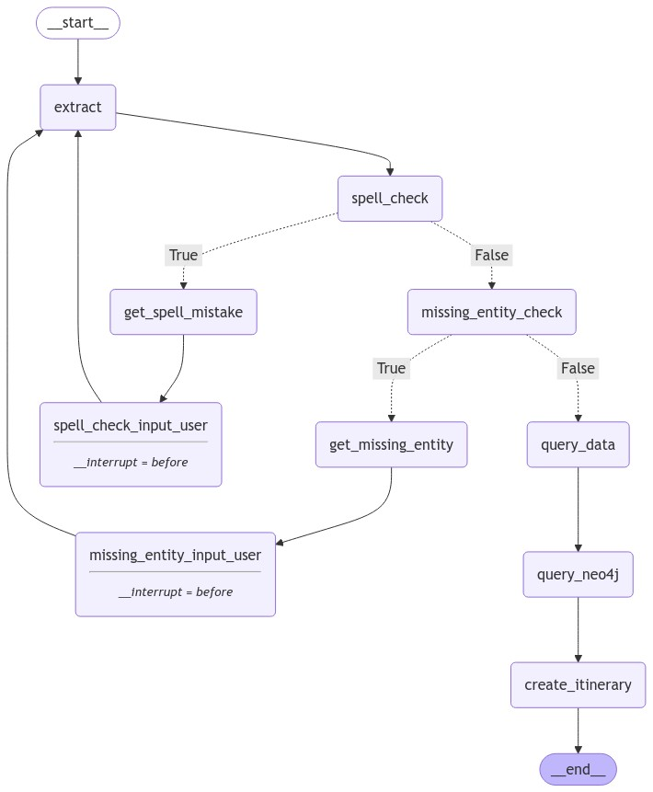
Breakpoint Integration
Currently working on integrating human feedback for verifying spell errors after entity extraction.

Slide 39
Week 5

Slide 40
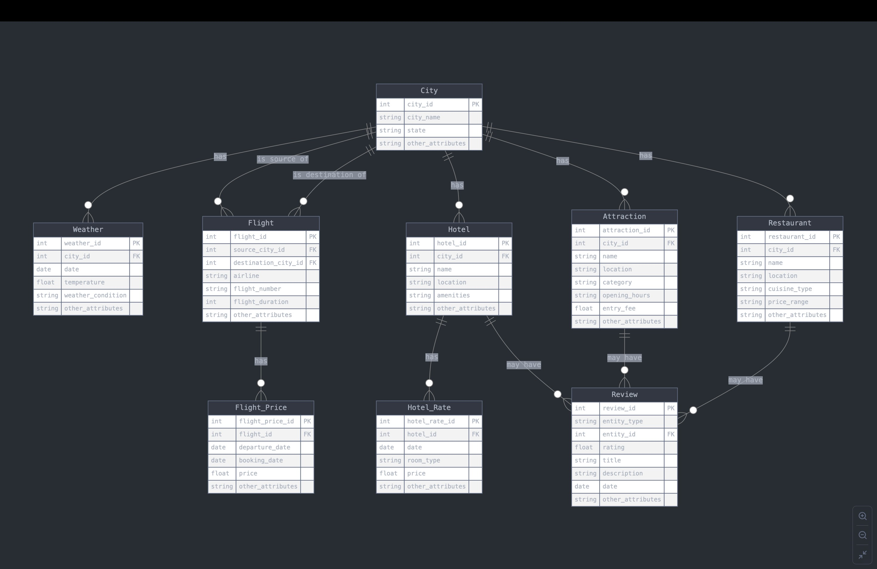
Schema

Slide 41
Standardization of Disparate Data Sets
A. Restaurant Reviews
Data Scraping: Completed scraping restaurant review data for 9 cities.
Data structure: Each city has a folder containing 100 CSV files, each with 10 reviews.
Data Transformation:
Extracted restaurant names from the CSV filenames and city names from folder names.
Added restaurant name and city name as columns to each record.
Merged all restaurant reviews from each city into a single file, e.g., merged_reviews_cityname.csv.

Slide 42
Standardization of Disparate Data Sets
B. Hotel Reviews
Data Merging:
Similarly processed hotel review data for all cities, merging reviews into merged_hotel_reviews_cityname.csv.
Added hotel name and city name as columns to each record.

Slide 43
Data Profiling
All Merged Attraction (259 columns):
All Merged Restaurant Reviews (246 columns):
All Merged Hotel Reviews (170 columns):

Slide 44
Data Profiling
All Merged Attraction Reviews (8 columns):
All Merged Restaurant Reviews (9 columns):
All Merged Hotel Reviews (6 columns):
Username | Rating | Review Title | Review Body | Review Date | Review URL | Attraction Name | City | ID
username | rating | review_title | review_body | date_visited | review_id | review_url | restaurant_name | city
review_id | rating | review_text | date_of_stay | Hotel Name | City

Slide 45
Ishan

Slide 46
RAG Workflow Updates
Perform LLMs model benchmarking for multiple entity extraction from user prompt.
Models Benchmarked:
Phi3 (microsoft/Phi-3-mini-128k-instruct)
Gemma2 (google/gemma-2-2b-it)
Llama3.2 (meta-llama/Llama-3.2-3B-Instruct)
Qwen2 (Qwen/Qwen2-1.5B-Instruct)

Slide 47
Performance Overview
Model | Execution Time | Spelling Correction | Entity Accuracy | Notes
Phi3 | 6.7s | Correct | High | Best for speed and accuracy
Gemma2 | 2m 18.4s | Correct | High | Accurate but very slow
Llama3.2 | 45.6s | Missed | Moderate | Average performance overall
Qwen2 | 10.2s | Missed | Moderate | Fast but less accurate

Slide 48
Human in the Loop - Workflow

Slide 49
Why LangGraph?
Fine-grained Control: LangGraph allows you to design workflows where human intervention can be controlled based on conditions (e.g., only trigger human feedback when spelling mistakes are detected).
Modularity: The framework supports a modular design where different components, such as entity extraction and spell-check correction, can be easily integrated and adapted.
Conditional Routing: You can introduce conditional nodes to optimize the workflow, ensuring that human input is only requested when needed.

Slide 50
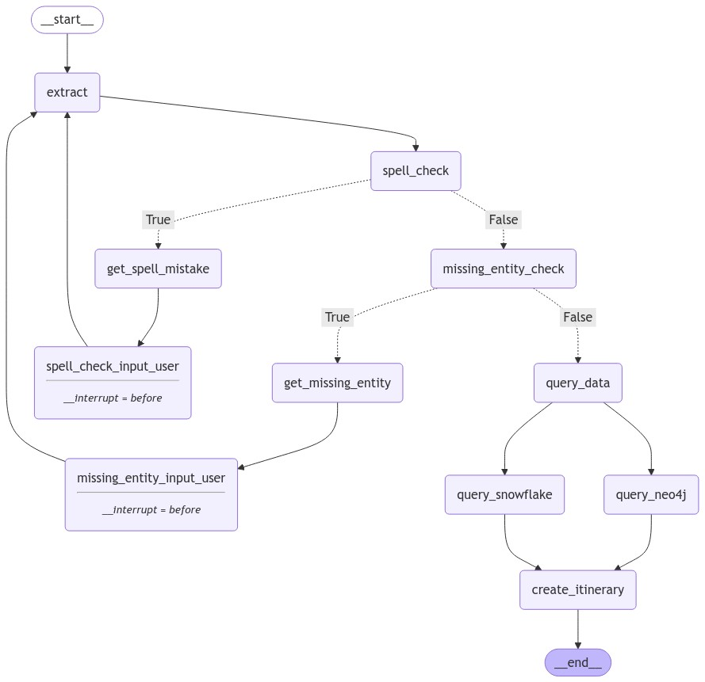
Breakpoint Integration
Nodes Definition:
extract – Extract entity from user prompt.
spell_check – Conditional node for spell checking.
get_spell_mistake – Return system prompt to clarify user's spelling mistakes.
spell_check_input_user – Take user input and process it for further correct entity extraction.
missing_entity_check - Conditional node for missing entity checking.
get_missing_entity - Return system prompt to clarify missing entity in user prompt.
missing_entity_input_user - Take user input and process it for further correct entity extraction.
query_data – Dummy node to pass data into query_snowflake and query_neo4j.
create_itinerary – Create an Itinerary using retrieved data from the knowledge base through the user prompt.

Slide 51
Task | Timeline | Milestones
1. Streamlit UI Creation & Connection | Oct 28 – Nov 18 | - Week 1: Design UI layout and structure. - Week 2: Implement input/output functionalities. - Week 3: Test integration with backend services.
2. Automate Data Ingestion (Snowflake to Neo4j) | Nov 19 – Dec 2 | - Week 4: Set up Snowflake schema and data pipeline. - Week 5: Integrate Snowflake and Neo4j; automate ingestion.
3. Research GraphRAG | Dec 2 – Dec 9 | - Week 6: Explore GraphRAG for enhanced retrieval and context. - Outline potential implementation approaches.
4. Neo4j Query Generation via LLM | Nov 11 – Dec 2 | - Week 3: Prototype Neo4j query generation using LLM. - Weeks 4-5: Test adaptability with various user inputs; integrate with Streamlit backend.
5. Optimize LangGraph Structure | Dec 2 – Dec 9 | - Week 6: Assess and streamline node dependencies in LangGraph for better performance.
6. Develop Auto-Evaluation Node | Dec 9 – Dec 13 | - Week 7: Implement LLM-based evaluation node to assess quality and relevance of responses in real-time.

